Slide 1
Advanced Excel project Sales Performance analysis Super store data set
Name: Sarayu Ravi
Batch :March-DADS-2025

Slide 2
Objective
The Main objective of this project is to analyze the sales and trends of superstore data and provide actionable insights to enhance business operations and profitable solutions for effective decision that supports business growth.
Goals of the project
Analyze the sales trends overtime
Identify high performing product category
Determine the impact of Sales by analyzing various fields in dataset.
Create a dynamic dashboard with KPI’s

Slide 3
The Superstore dataset contains detailed transactional data from business, capturing various aspects of sales
Order ID – Unique identifier for each order
Order Date – Date when the order was placed
Ship Date – Date when the order was shipped
Customer ID – Unique identifier for each customer
Segment – Customer segment (e.g., Consumer, Corporate, Home Office)
Category – High-level product category (e.g., Furniture, Office Supplies)
Sub-Category – More specific product type

Slide 4
Data Cleaning process
Removed duplicate rows using remove duplicates by selecting entire sheet
in the dataset.
Used data validation techniques to ensure that all data entries are correct
Sorted date columns and removed blank rows using GO TO-→special -→blank
Used max function and removed negative values from profit column
Identified and resolved outliers especially in Sales and Discount.
using quartile function.

Slide 5
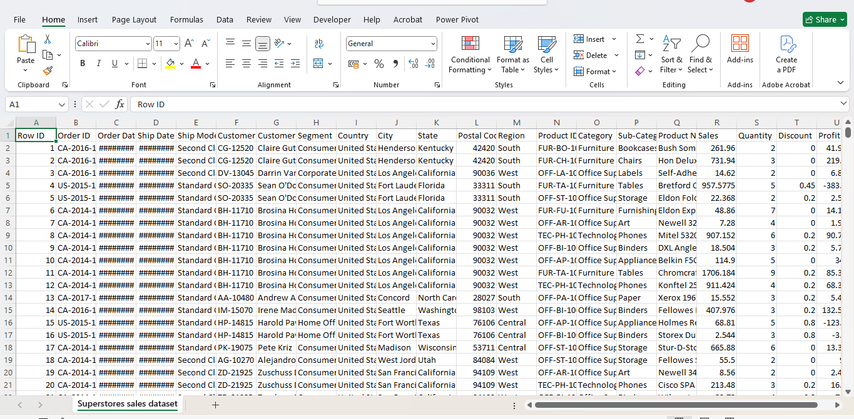
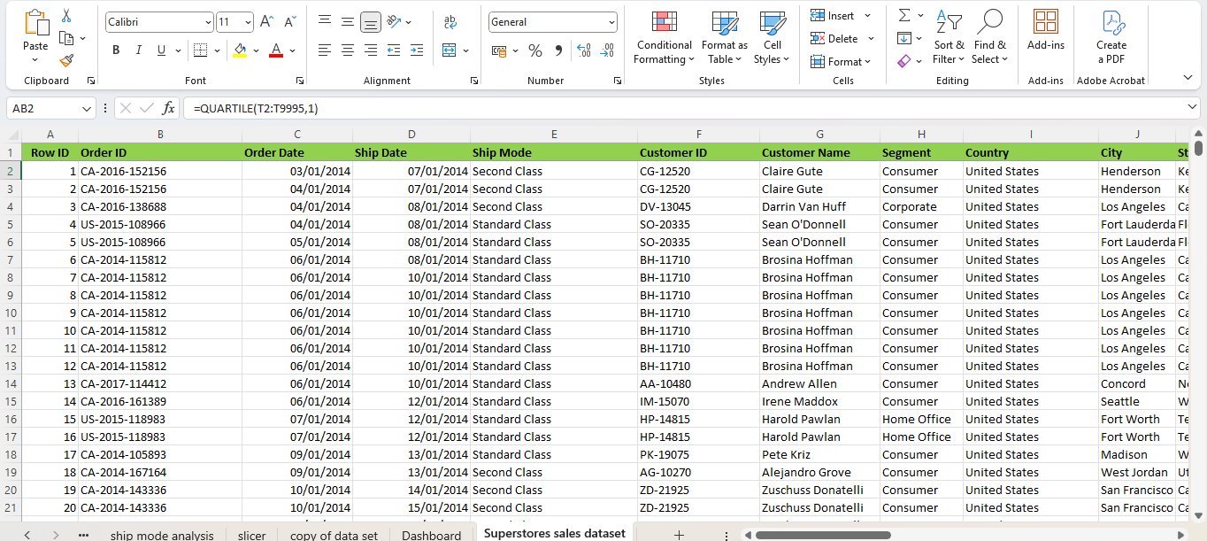
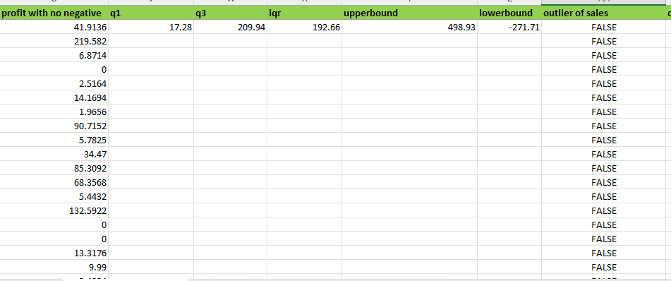
Screenshots of data set before and after cleaning

Slide 6
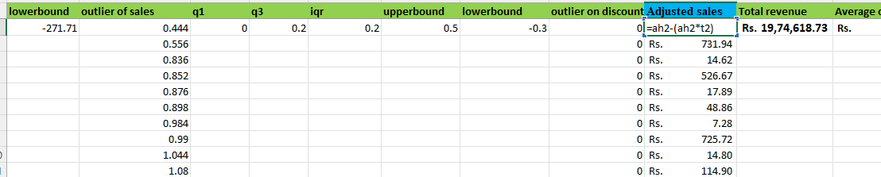
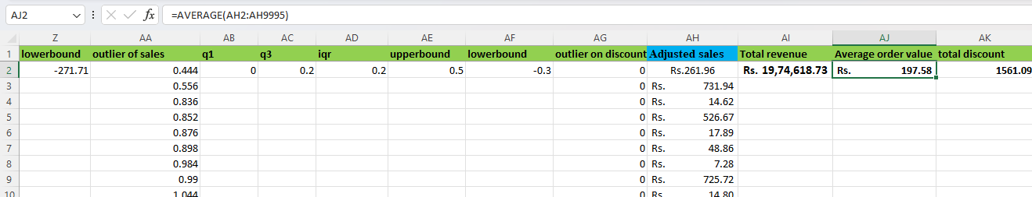
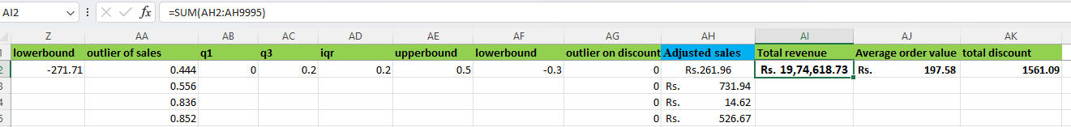
Screenshots of KPI
1)Adjusted Sales=sales-(sales*discount) 2)Total revenue=sum(adjusted sales) 3)Average order value=average(adjusted sales)

Slide 7
Pivot tables and Pivot charts
To analyze sales data efficiently, I utilized PivotTables in Excel to aggregate and summarize key metrics by various dimensions:
Analyzed sales based on
Product Category
Segment and Ship mode
Sales by over time based on order date
Top 10 products based on sales
Average order per sales

Slide 8
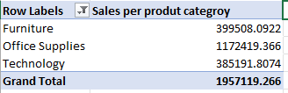
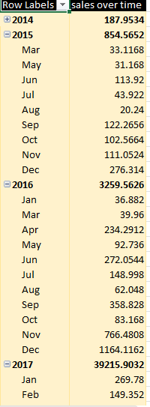
Screenshots of pivot table and charts

Slide 9
Dashboard
The dashboard was designed to know about the analysis performed on the data by visualizing to audience to present key business insights at a glance. Also it aids for decision making process
It gives information about
Key Performance Indicators (KPIs) for immediate insight into performance
Charts (Pivot Charts) to visualize trends, comparisons, and patterns
Slicers for filtering data dynamically by fields such as segment ,ship mode and or product category.

Slide 10
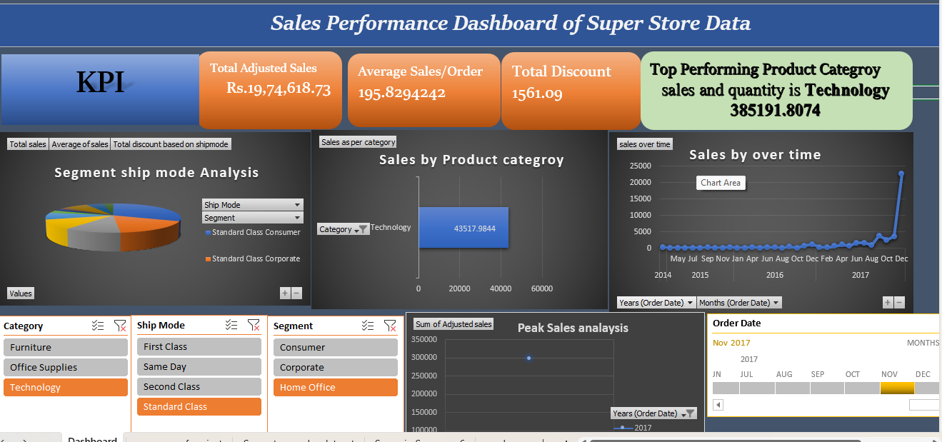

Slide 11
What –if analysis and Goal seek
What-if analysis and goal seek are powerful tools in excel in forecasting the future and enables decision making process easier in business.
In this project ,I used what-if analysis- Goal seek to obtain the profit of specific amount (ex.Rs.10,0000)how much units should be produced.
Used scenario manager to test different scenarios for total revenue
when sales is increased by 10%and discount decreased by 5%

Slide 12
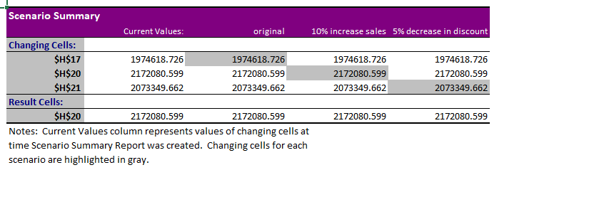
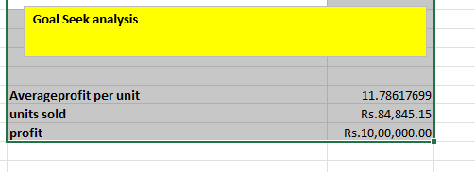
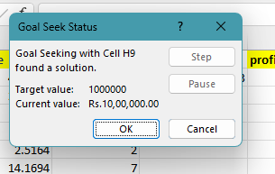
Screenshots of Goal seek and Scenario Manager

Slide 13
Macros
To automate the task of workflow ,I utilized Excel Macros by recording a series of actions that were frequently repeated throughout the analysis process. Key tasks automated using macros included
Data formatting
Pivot table summary for fields for adjusted sales and category.
Created a button to automate the tasks .

Slide 14
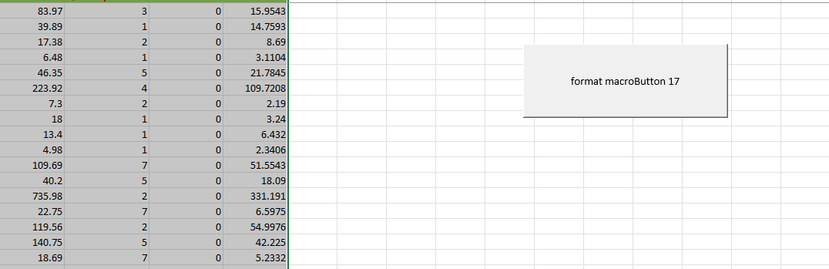
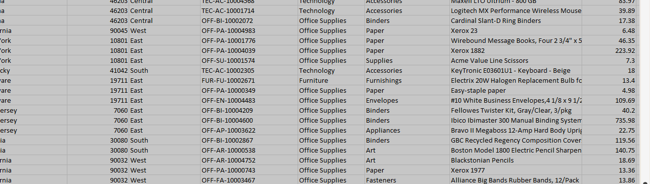
Macro visuals

Slide 15
Power Pivot
Power Pivot is a powerful data modeling and analysis tool allowing users to import and relate data from various sources, create calculations, and build reports.
It enables the creation of data models, establishing relationships between tables and performing calculations using DAX (Data Analysis Expressions). This tool is particularly useful for working with large datasets and complex analysis tasks.
In this Project used power pivot to create a relationship between Product,customer,and sales transaction table.
Also, Calculated profit per unit using formula in DAX =DIVIDE([Profit with no negative], [Sales])and transformed the result in to Pivot table.

Slide 16
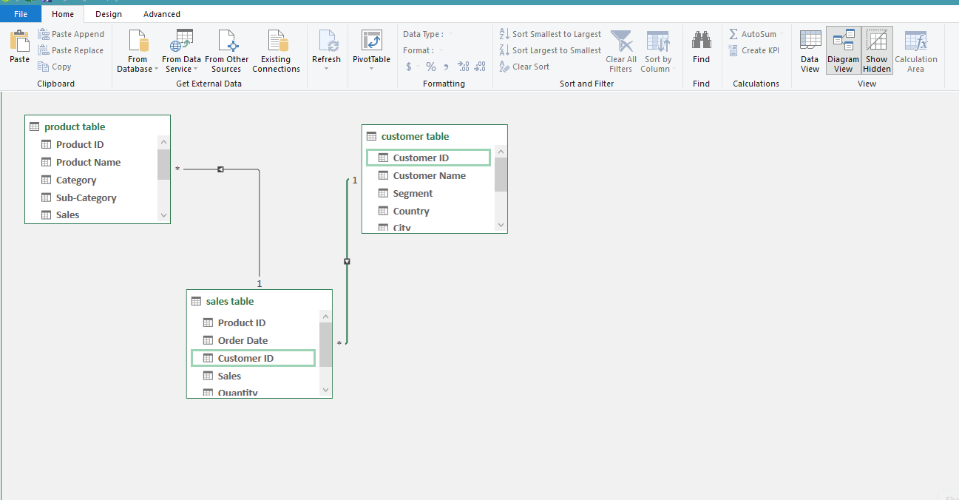
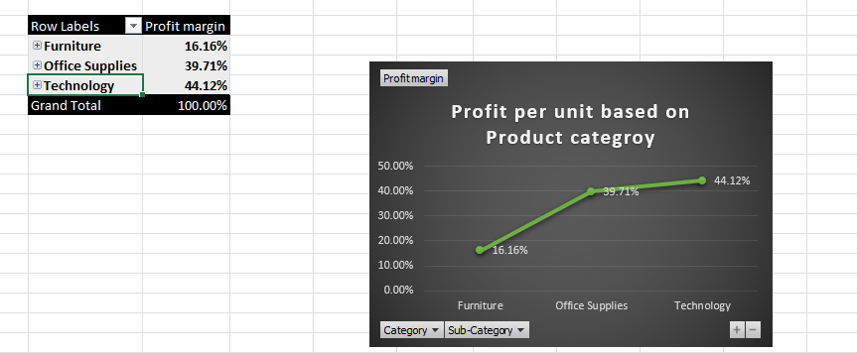
Power Pivot Visuals

Slide 17
Insights and Recommendations
Product Categories are performing best and worst based on Adjusted Sales and Quantity.
Best Category: 🔹 Technology — Strong Adjusted Sales due to high-value items, even with discounts
Office supplies –high volume and it meets the baseline of sales Worst Category: 🔹 Furniture — Low Adjusted Sales, lowest quantity sold.
The effect of Discounts Adjusted Sales.
Higher discount=>(20%-50%)impacts Total revenue which is sum of Adjusted sales.
Implies there will be loss in the total revenue in turn affects the profit especially if the product or category inventory is low.

Slide 18
Visuals

Slide 19
Conclusion
From above analysis
Furniture shows the biggest drop between Net Sales and Adjusted Sales due to high discounting.
Technology maintains good margins even with small discounts due.
Recommendations
Can improve marketing strategy for category Technology also maintain inventory
Promoting frequently used products along with Technology.
Ex: laptop with headset along with microphone.
Identify top regions, customer segments, or ship modes.
Prepare a campaign and stalls personalized campaigns for product category Technology.
Maintaining Low Discount, on High Volume Products
Use Office Supplies in volume-driven deals or use with frequently used products to make the customer consideration of product .
Improve same day delivery or deliver with in a day in ship modes
Customers who get their orders delivered faster are most likely to buy again

Slide 20
Questions

Slide 21
Thank you

